Slide 1
Cocaine Effects
Student Name
Institution Affiliation

Slide 2
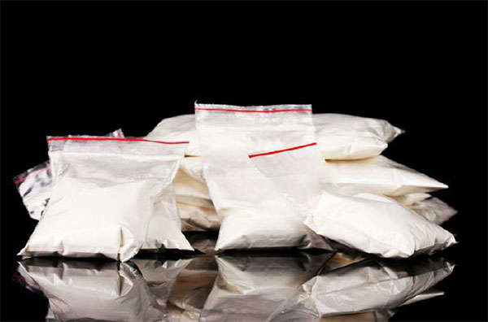
Scope of Cocaine Use
Cocaine is the second most popular illegal drug in United States
Adults aged between 18 top 25 years have been holding the highest percentage use in my race.
According to National Survey on Drug Use and Health study in 2015 found that over 1.9 million individuals aged 12 years and above have used cocaine or crack cocaine.
Notes:
Cocaine is the second most popular illegal drug next from marijuana in here in the United States. Additionally, it is the second most deadly illicit drug next from heroin. The drug has been mostly used by young adults aged 18 to 25 years in my race in the past years. They have been using both cocaine and crack cocaine (Kalechstein & Newton, 2017).

Slide 3
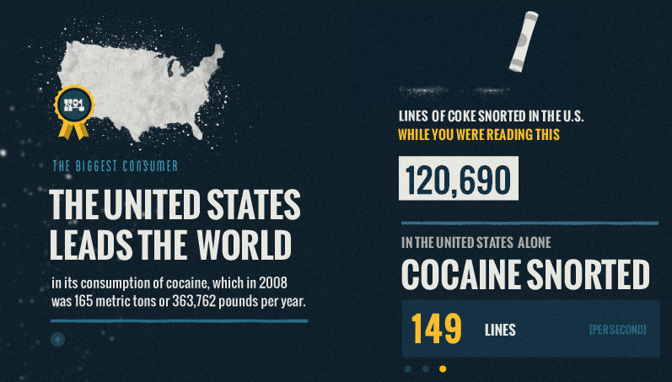
Cocaine Use
Addition has increased due to repeated cocaine use
The number of visitors in emergency departments due to cocaine use has been increasing.
40% of emergency visits in facilities within may state are cocaine abusers
Notes:
Repeated cocaine use has been reported to cause addiction among the user. The mental facilities have been received a large number of patients suffering from cocaine addiction. Additionally, emergency facilities have been receiving a large number of patients who have abused cocaine. In fact, most of the facilities in the past years indicated that 40% of their patient visit the facilities as a result of cocaine abuse (Havakuk, Rezkalla & Kloner, 2017).

Slide 4

Cocaine Admininistration
Occasional users
Compulsive or repeated users.
Notes:
Cocaine users in my race have been using cocaine as occasional; users and other repeated users. However, regardless of the route of administration, the users of cocaine have been leading to absorption of toxic amounts of cocaine hence in most cases leading to diseases such as attacks, strokes or even sudden death (John, & Wu, 2017).

Slide 5
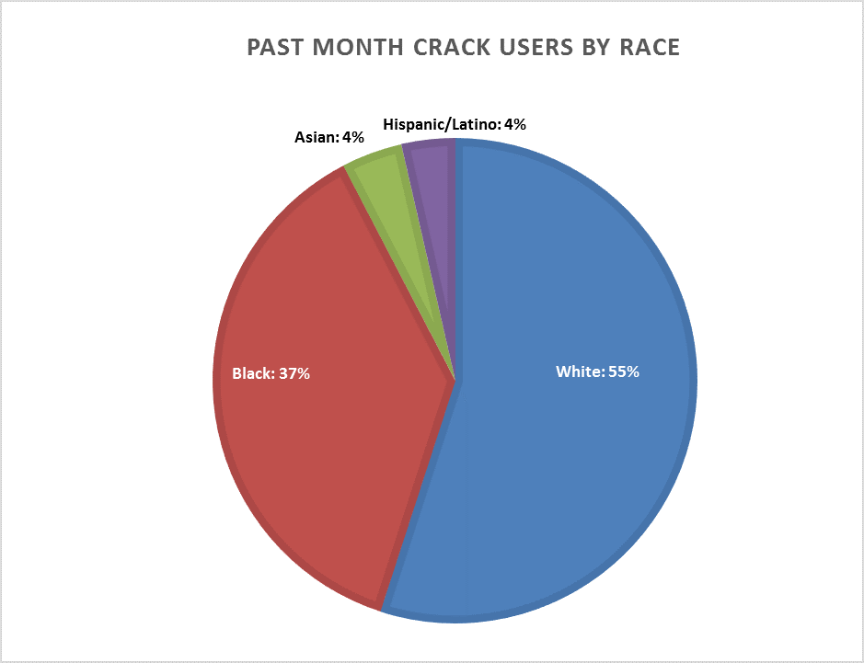
Cocaine Use by Race
Notes:
Research indicates that the Whites lead in cocaine use followed by the Blacks, then the Asian and Latino’s respectively.

Slide 6
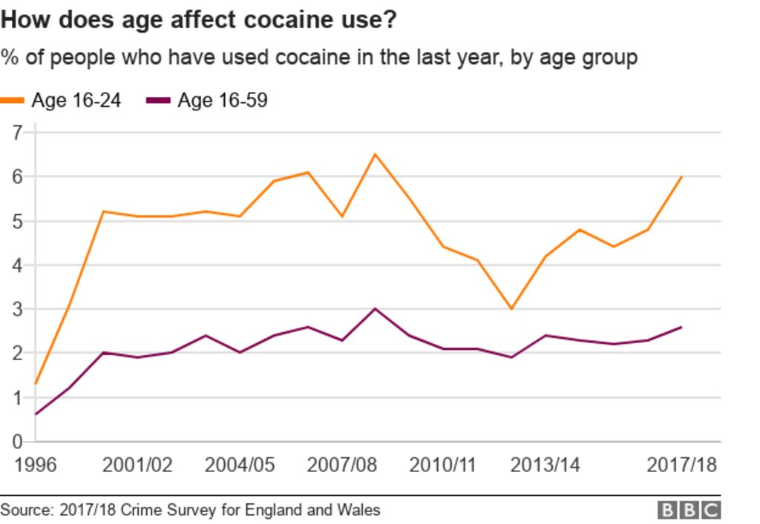
Cocaine use By Age
Notes:
Individuals aged 16-24 in my race use cocaine more than those aged over 24 years. They have been much affected by cocaine and most of them are addicted and need rehabilitation.

Slide 7
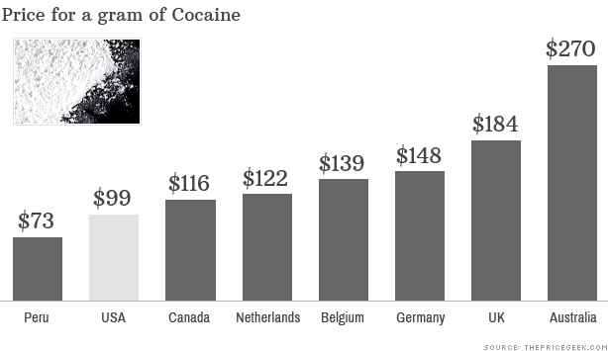
Effects of Cocaine prices on Cocaine use
Notes:
Cocaine is cheaper in US hence making it affordable to most individuals including college students. This has increased the abuse of cocaine in my race in the pats 7 years.

Slide 8
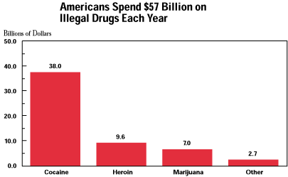
Individuals Spending on Cocaine
Notes:
Americans spend approximately 28 billion on cocaine. This implies that most individuals in my race have been affected financially due to the need of spending more on cocaine hence been left with nothing to cater for their families.

Slide 9

Home and Workforce Effect of Cocaine
Decrease ion need for food
Decrease in need for sleep
Hinder performance of simple physical and intellectual tasks
Notes:
Most parents in the past years have been complaining about the behavior of their youths due to the influence of cocaine. They have been reporting that after taking cocaine, their children rarely take food or get some sleep something they say has affected their life well being. Additionally, organizations have been c0omplaining of the performance of their workforce who abuse cocaine (O'Neill, Cardenas & Meyerhoff, 2001).

Slide 10
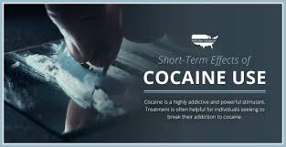
Heath Effect of Cocaine
Cocaine abuse within my race has lead to increased patients visiting health facilities with complications such as;
constricted blood vessels
dilated pupils
increased body temperature, heart rate, and blood pressure
bizarre, erratic, and violent behavior
anxiety, panic, and paranoia
tremors, vertigo, and muscle twitches
Notes:
Facilities have been receiving a large number of patients in the past years with various complications that have been determines to because of cocaine abuse. Most of them get treatment and later come back with similar or different complication due to continued cocaine abuse (Dahal, Chitti, Nair & Saxena, 2015).

Slide 11
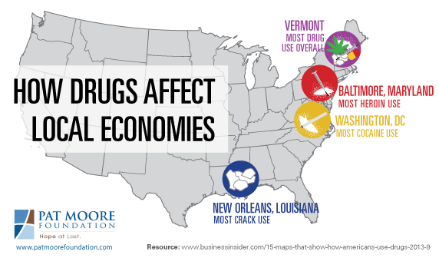
Cocaine Use Economic Effects
Reduced labor force
Increased Crime rate
Increased State spending
Notes:
Adults aged 18 to 25 years contribute a lot to the state economy since they form the most significant labor force. However, the use of cocaine by this group has adversely affected the economy. The labor force has reduced since most of the workers are unable to undertake their duties under the influence of drugs. Additionally, the crime rate has increased since under the influence of cocaine, individuals are unable to wo0rk hence engaging in criminal acts to raise money. Furthermore, the state government is spending more to try to implement capital intensive methods in firms since laborers are few (O'Neill, Cardenas & Meyerhoff, 2001).

Slide 12
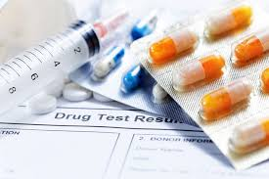
Cocaine Use Impact to the Health Sector
Increased state spending on health care facilities
Congestion in facilities
Huge time consumption
Notes:
Cocaine use in our raise has in the past years increased the state spending on health care facilities. More rehabilitation centers have been built to help those addicted. Additionally, facilities especially emergency facilities have had a large number of patients visits increasing the congestion in the facilities. Also, health care professionals have been spending a lot of time taking care of the patients suffering from cocaine abuse hence even sometimes lacking the time to attend other patients (Dahal, Chitti, Nair & Saxena, 2015).

Slide 13

Effects of Cocaine Use to Families
Decreased sex functions
Reproductive damaged and infertility for both men and women.
Irresponsibility
Notes:
Cocaine use in the past years has increased the number of conflicts in families. Most of the users of cocaine have been experiencing decreased sex functions hence having their partners complain from time to time. Additionally, some people have become infertile due to the persisted use of cocaine therefore causing family breakups. Additionally, a man or a woman who is using cocaine in the family has become more irresponsible hence even making the children also engage themselves in the same (Dahal, Chitti, Nair & Saxena, 2015).

Slide 14

Effects of Cocaine to Pregnant Mothers
Premature birth
Low birth weight
Miscarriage
Neonatal abstinence syndrome
Notes:
Cocaine use among women had lead to several effects on pregnant mothers in my race. Many mothers in the past years have experience premature births according to the facilities report. Such mothers are reported to have used cocaine at one point in life. Also, most of the mother who have been using cocaine have experienced low birth weights that are they have been giving births to children weight less than 5 pounds. Additionally, the most mother who has experienced a miscarriage in my race is reported to have been abusing cocaine. Mothers abusing cocaine have given birth to newborns with Neonatal abstinence syndrome condition (Dahal, Chitti, Nair & Saxena, 2015).

Slide 15

Effects of Cocaine to Pregnant Mothers Cont’d
Fetal death
Cocaine withdrawal in a newborn
Sudden infant death syndrome
Notes:
In the past 5 years, most fetal deaths have been associated with arising among mothers abusing cocaine. Additionally, most babies born to mothers who depend on cocaine have also been born dependent on the drug hence suffering from withdrawal after birth. This has been making the babies have difficulties in feeding and sleeping. Lastly, children born to mothers abusing drugs have been experiencing unexplained deaths during sleep (Bedi, et al., 2016).

Slide 16
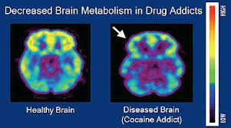
Effects of Cocaine Use in Education
Students low performance
Increased Sexual harassments among students
Increased high school drop outs.
Notes:
Cocaine use usually reduces the brain IQ hence has been affecting the performance o0f most high school and college students. Additionally, many cases of students harassing their colleagues sexually in colleges while under the influences have been highly reported in the past years. The number of high school dropouts in the past pats years has been as a result of cocaine abuse (Dahal, Chitti, Nair & Saxena, 2015).

Slide 17

Effects of Cocaine Use in Education Cont’d
Students missing classes due to health complications
Diseases infection among students
Legal complications
Injuries and deaths
Notes:
Cocaine use among students has also made most of them miss classes several times during school sessions due to health complications that they develop from abusing drugs. Additionally, research done last year showed that the number of infection of sexually transmitted diseases among students has increased. This is because when under cocaine influence, they have been engaging in unprotected sex practices. Most students have also lost employment opportunities due to the use of cocaine in which they fail to pass the drug tests done by most employees. Lastly, several cases of injury and deaths among students while under the influence of cocaine were reported (Bedi, et al., 2016).

Slide 18
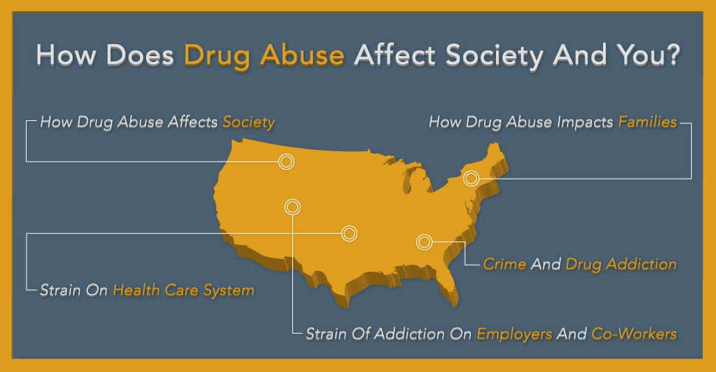
Effects of Cocaine Use to the Community
Cocaine use hurts individuals finances
Cocaine use hurts individuals freedom in the society
Cocaine use hurts romantic relationships
Notes:
Individuals financial status within the community has been hurt due to their abuse of cocaine. Cocaine cost money; hence individuals have been spending more on cocaine thus hurting their financial status. Additionally, many individuals have got their freedom hurt due to cocaine use since most of them have in the last few years landed in jail. Cocaine abuse has hurt individuals romantic relationship since trust issue have been raising due to drug abuse (Bedi, et al., 2016).

Slide 19

Effects of Cocaine Use to the Community Cont’d
Cocaine use hurts family relationships
Cocaine abuse have increased immorality in the community.
Cocaine abuse has increased accidents
Notes:
Due to repeated use of cocaine, individuals have shifted family preferences to cocaine choice hence leading to break up of family relationships. Additionally, immorality mostly prostitution in the past few years has increased due to cocaine abuse. Lastly, many accidents recorded in my state in the last seven years have been caused by individuals under the influence of cocaine (Dahal, Chitti, Nair & Saxena, 2015).

Slide 20
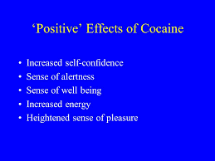
Positive effects of cocaine Use
Helps individuals relax
Helps individuals socialize
Helps individuals feel less tired
Notes:
Individuals with social anxiety hence having challenges in the social situation have in the past years depicted that cocaine has helped them socialize. Additionally, a survey done in my state depicted that cocaine users get more relaxed after using it hence being able to top escape stress. Lastly, individuals who undertake tiresome tasks have pointed out that cocaine use makes them feel less tired (Bedi, et al., 2016).

Slide 21
References
Kalechstein, A. D., & Newton, T. F. (2017). The limited impact that cocaine use patterns have on neurocognitive functioning in individuals with cocaine use disorder. Journal of psychopharmacology (Oxford, England), 31(8), 989-995.
Havakuk, O., Rezkalla, S. H., & Kloner, R. A. (2017). The cardiovascular effects of cocaine. Journal of the American College of Cardiology, 70(1), 101-113.
John, W. S., & Wu, L. T. (2017). Trends and correlates of cocaine use and cocaine use disorder in the United States from 2011 to 2015. Drug and alcohol dependence, 180, 376-384.
O'Neill, J., Cardenas, V. A., & Meyerhoff, D. J. (2001). Separate and interactive effects of cocaine and alcohol dependence on brain structures and metabolites: quantitative MRI and proton MR spectroscopic imaging. Addiction biology, 6(4), 347-361.
Dahal, S., Chitti, S. V., Nair, M. P., & Saxena, S. K. (2015). Interactive effects of cocaine on HIV infection: implication in HIV-associated neurocognitive disorder and neuroAIDS. Frontiers in microbiology, 6, 931.
Bedi, G., Shiffrin, L., Vadhan, N. P., Nunes, E. V., Foltin, R. W., & Bisaga, A. (2016). Effects of levodopa-carbidopa-entacapone and smoked cocaine on facial affect recognition in cocaine smokers. Journal of Psychopharmacology, 30(4), 370-377.

